Slide 1
Measuring Salinity in the Habitat beneath the Antarctic Ice Shelves
Author: Cameron Clark
Supervisor: Justin Pead
Department of Electrical Engineering
University of Cape Town

Slide 2
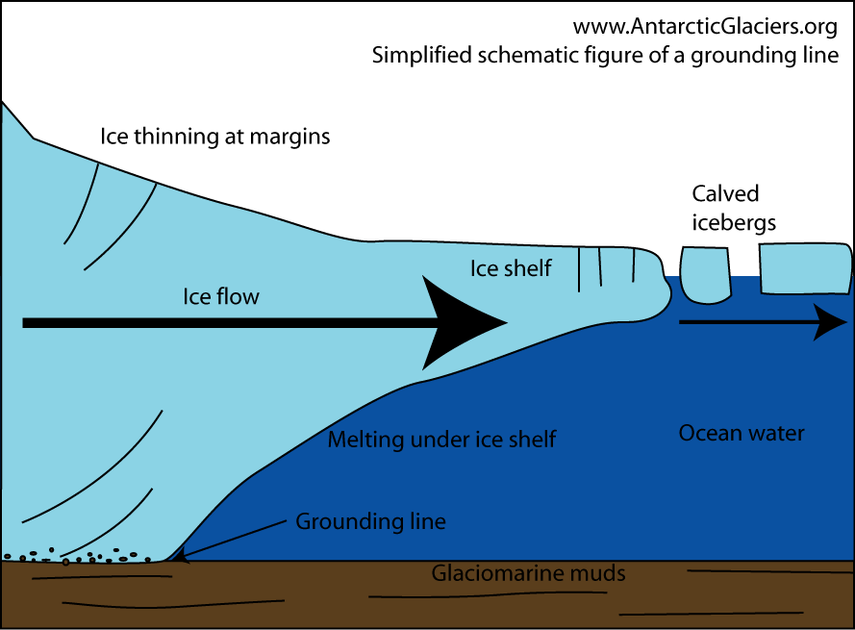
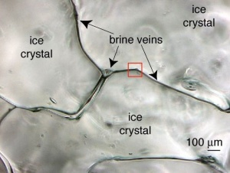
Background
Antarctic ice shelves are a habitat for microorganisms
Brine channels and ocean water form a mixing zone beneath the ice
Antarctic Ice Shelves. Source: AntarcticGlaciers.org
Brine Channels. Source: greenedge-expeditions.com

Slide 3
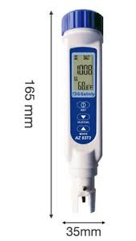
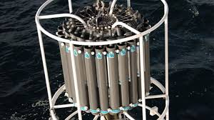
Literature and Devices
Methods: chlorinity, conductivity, density, electromagnetic interactions, magnetic permeability.
Commercial CTDs are either too large, too expensive or handheld.
Large CTD. Source: oceanexplorer.noaa.gov
Handheld CTD. Source: ecotao0store.co.za

Slide 4
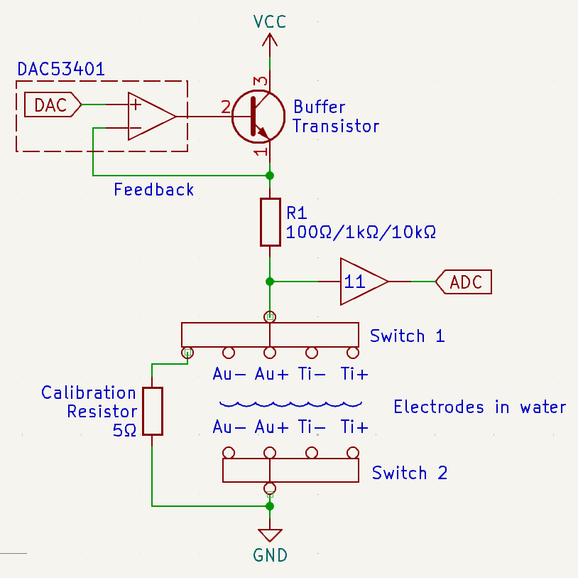
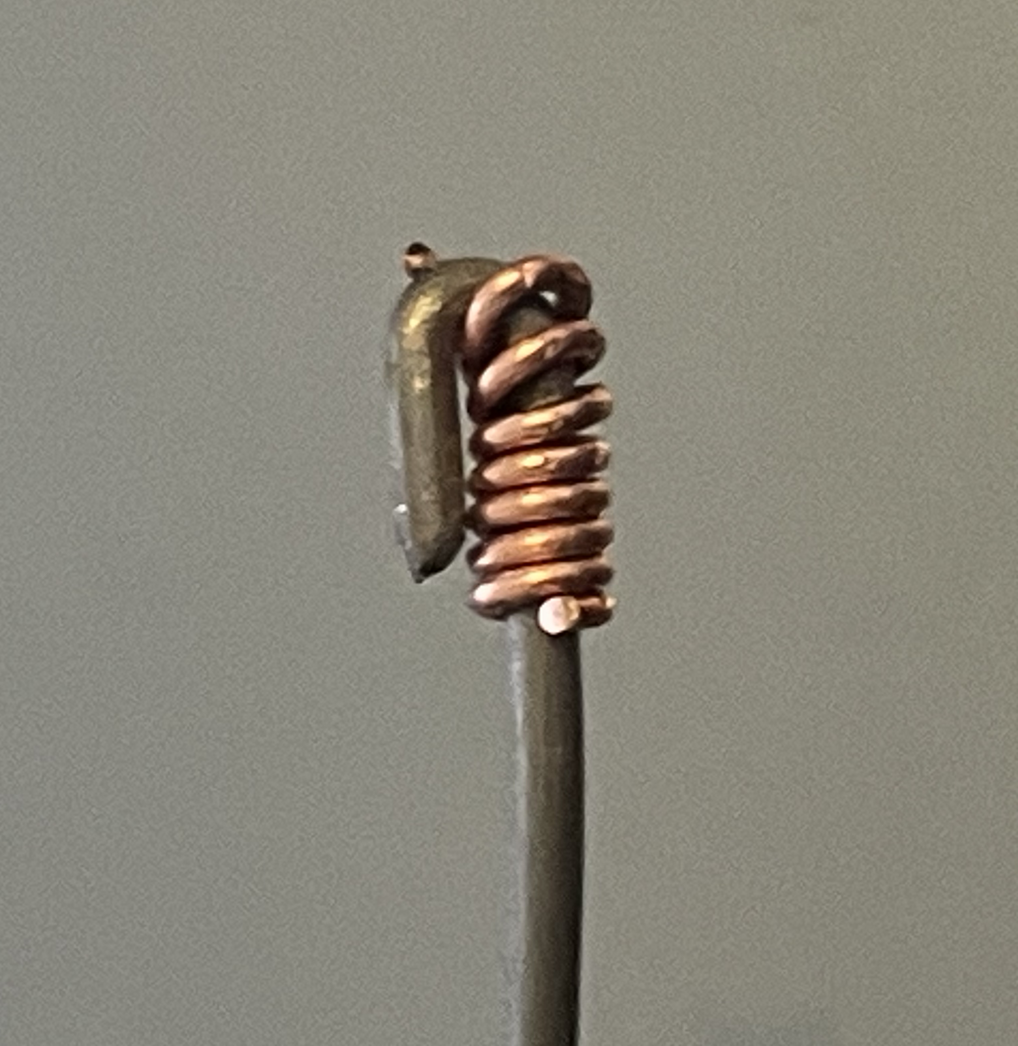

Design
Uses electrical conductivity
Electrodes made from gold and titanium
Resistance measuring circuitry
Switching current to prevent corrosion
Calibration resistor for measurements
Circuit Overview
Titanium Electrode
Gold Electrode

Slide 5
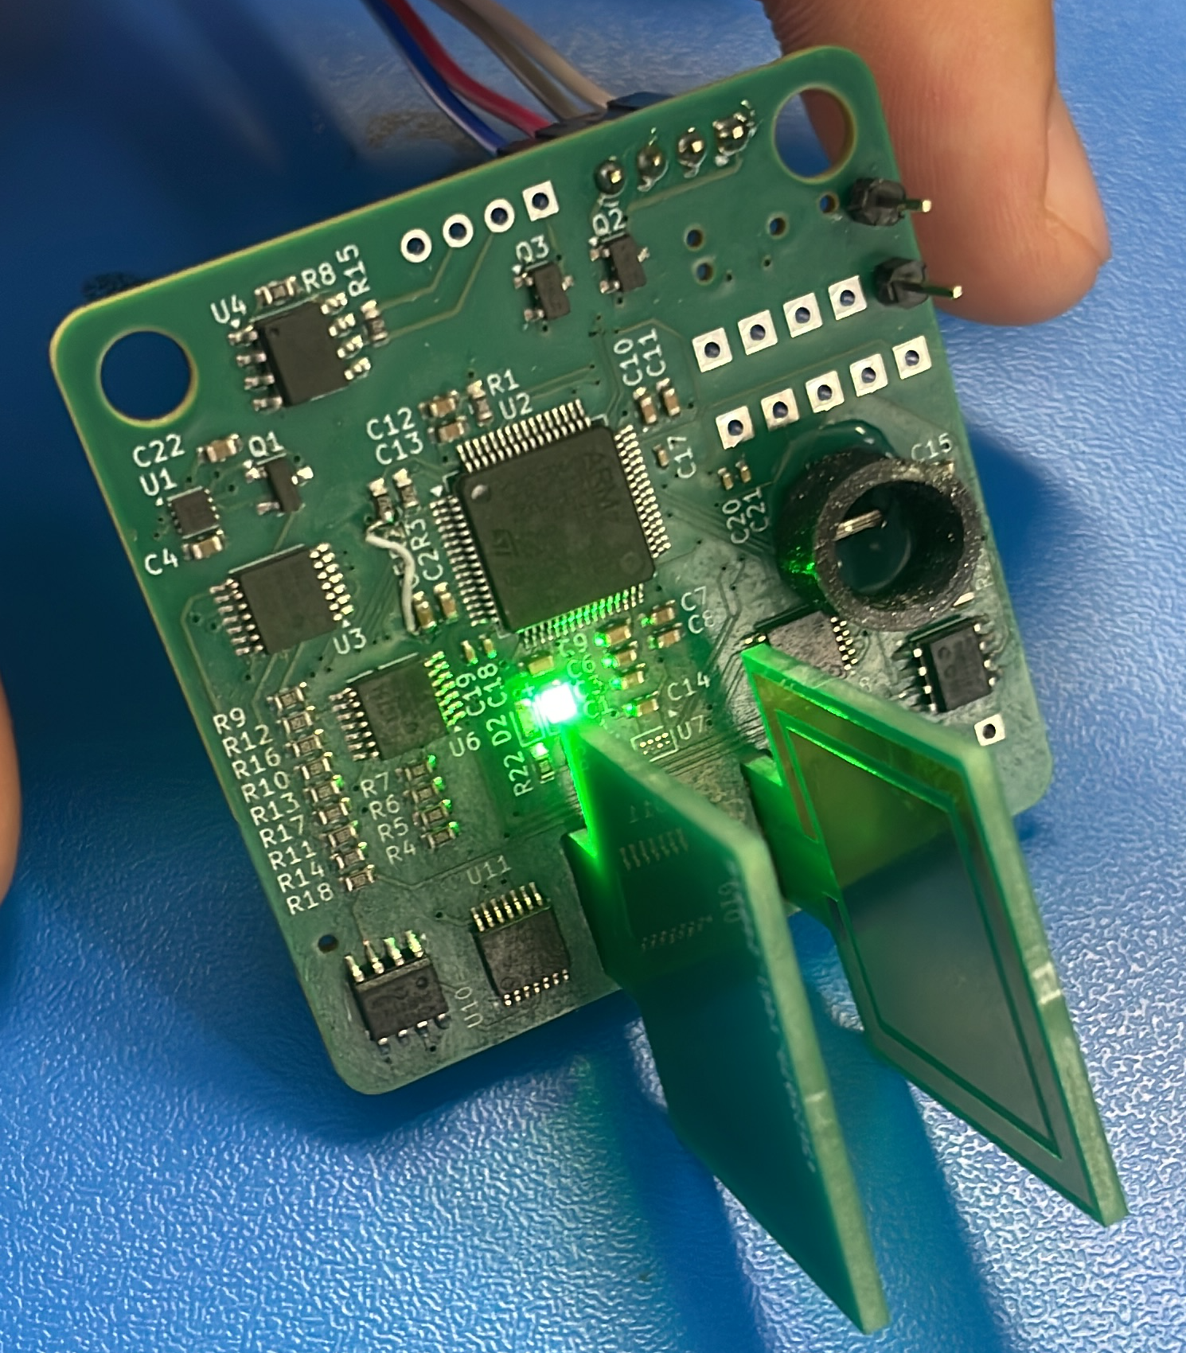
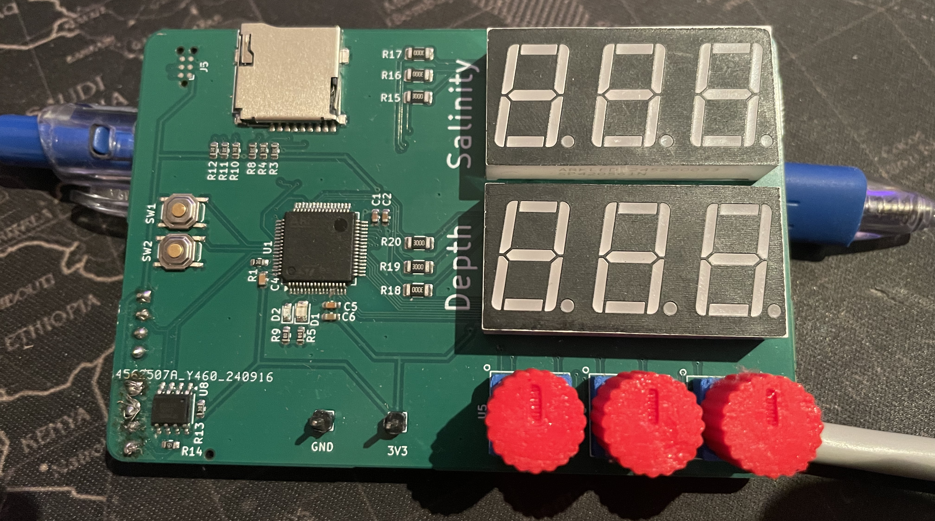
Design
Probe and controller PCBs were fabricated
Controller requests and displays measurements
Board to board communication over RS485
Probe PCB
Controller PCB

Slide 6
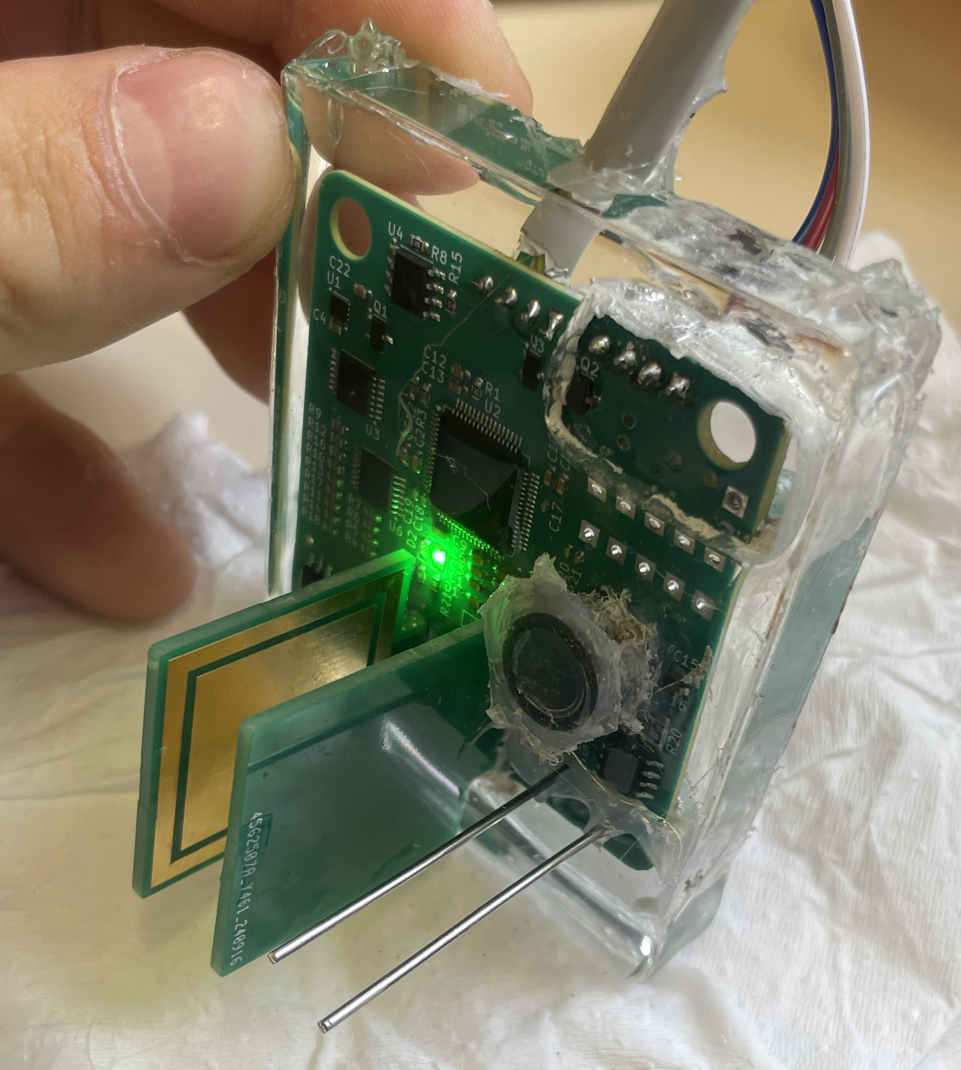
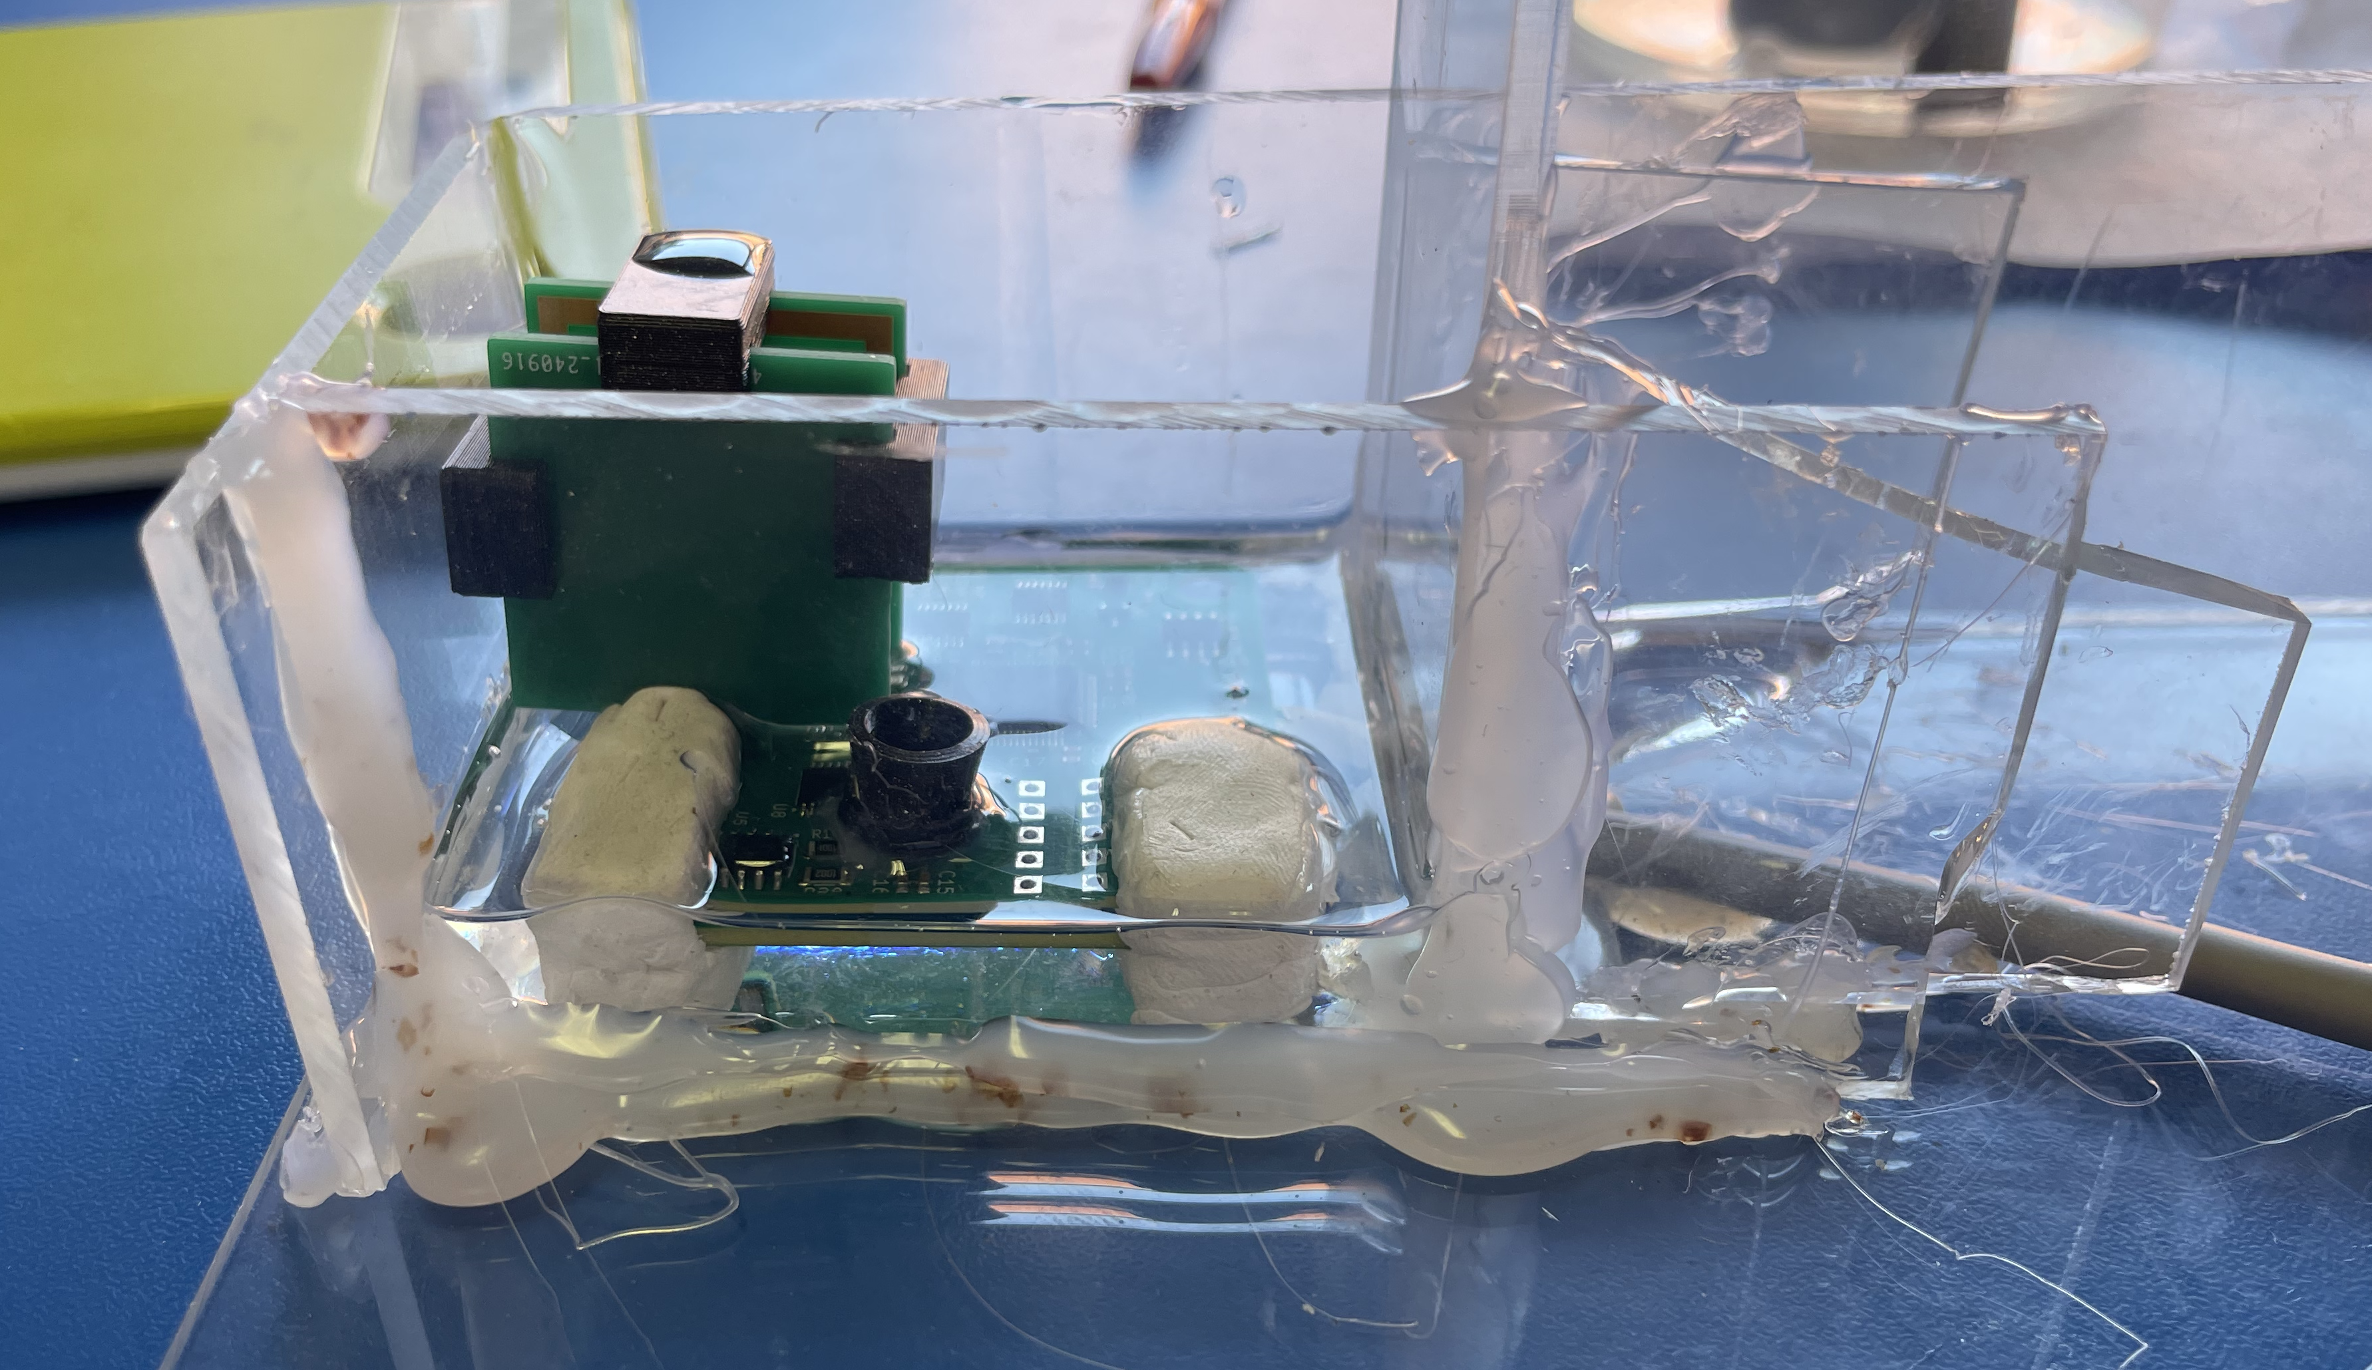
Implementation
Probe was cast into epoxy
Depth sensor was a pressure sensor isolated with a flexible membrane
Probe PCB Cast in Epoxy
Epoxy Casting Mould

Slide 7
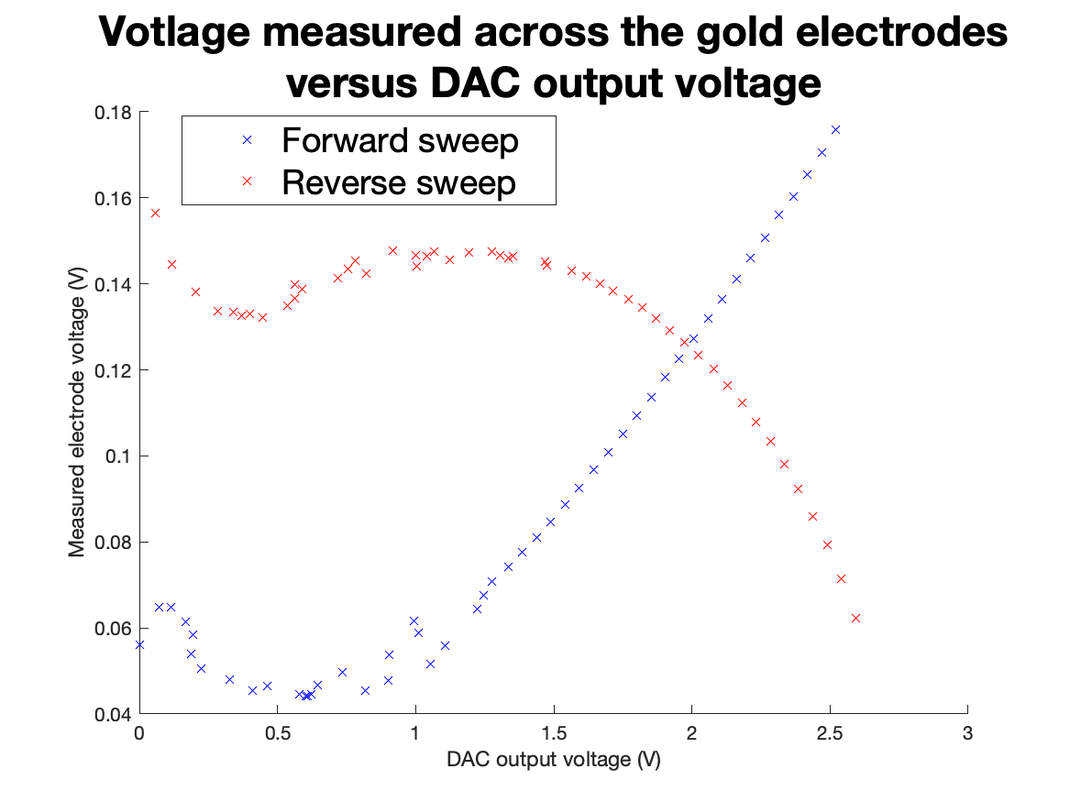
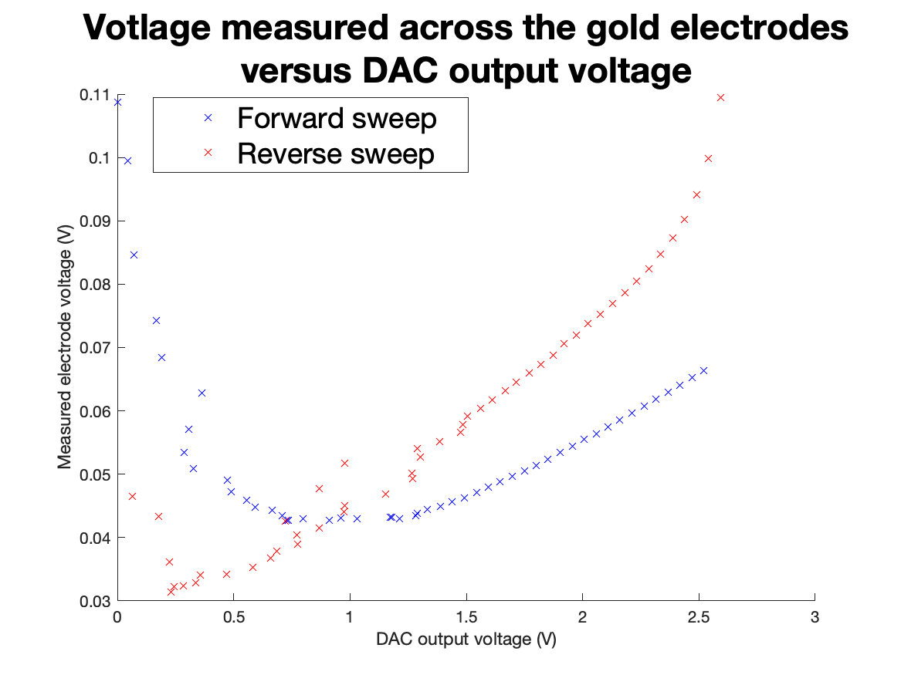
Testing
Voltage sweeps stepped through a range of voltages
Measurements affect the samples
Forward and Reverse Sweeps
Forward and Reverse Sweeps with Priming

Slide 8
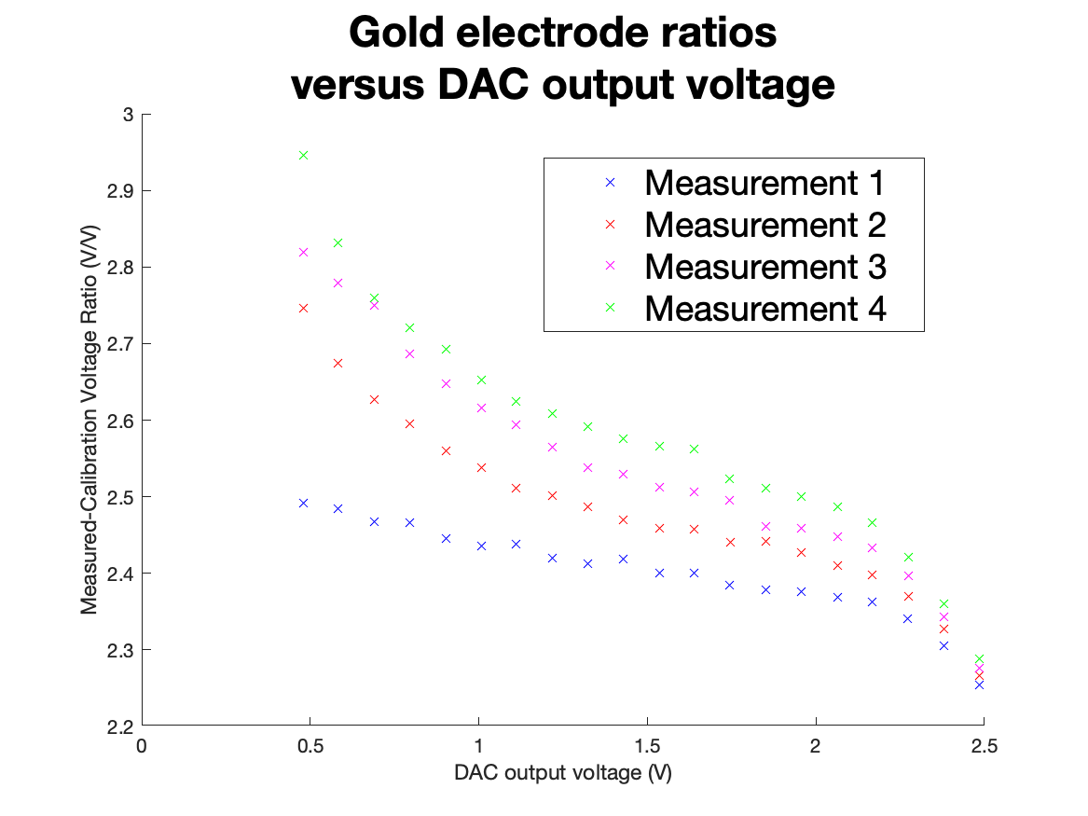
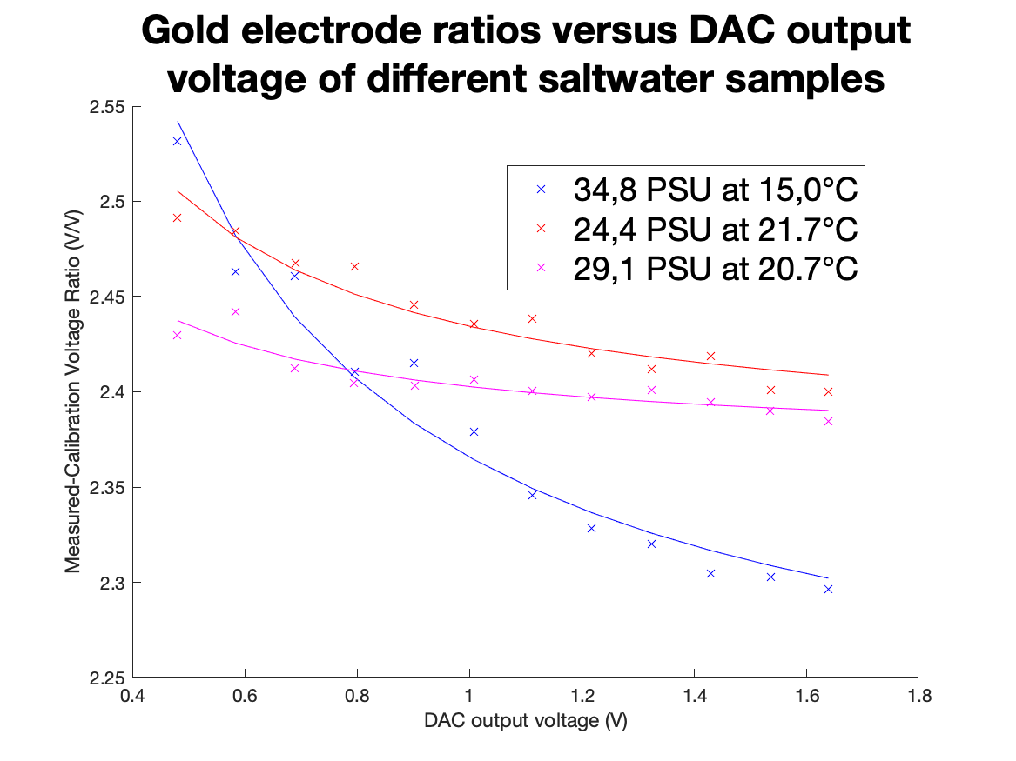
Testing
Voltage sweeps at similar temperatures showed logical differences
Equation of best fit was parameterised and used to calculate salinity.
Gold Electrode Sweeps of the Same Sample
Gold Electrode Sweeps of Different Samples

Slide 9
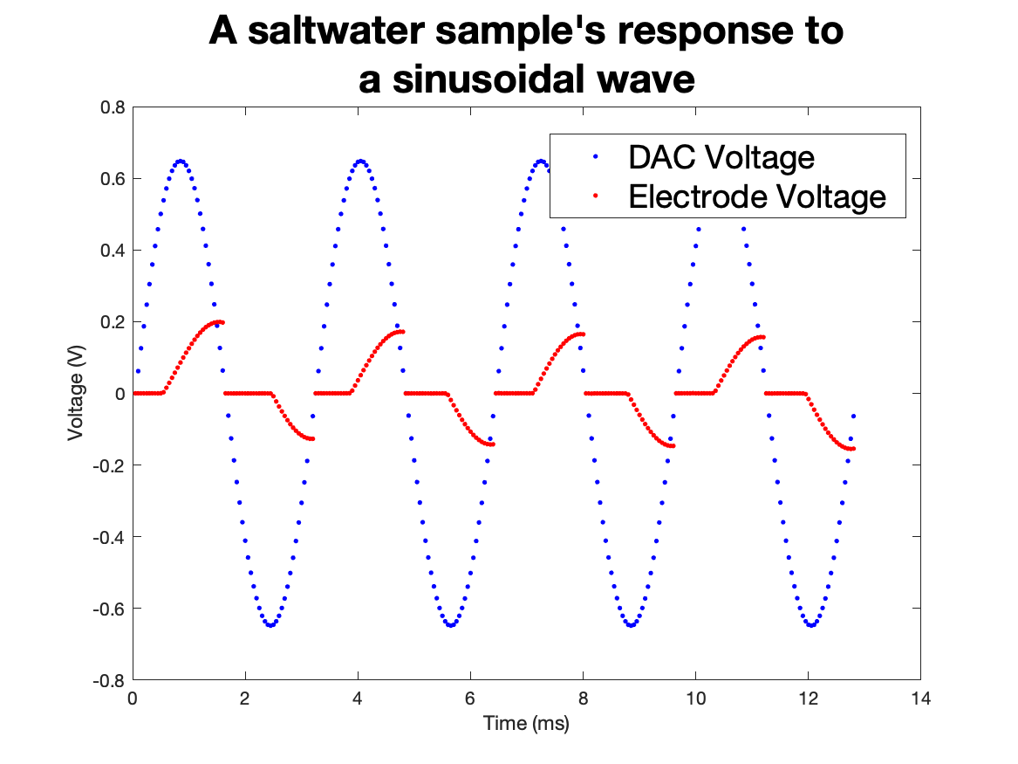
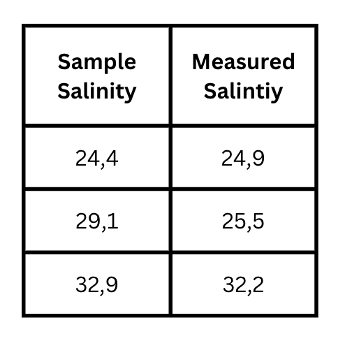
Testing
Sine wave tests were unable to differentiate between samples.
Single measurements were accurate with a correlation coefficient of 0,87
Sine Wave Testing
Single Measurement Testing

Slide 10
Recommendations
Pump a sample of water over the electrodes to prevent the priming effect in the voltage sweeps.
Creating a probe dedicated for measuring AC responses.
Use an LCD on the controller.

Slide 11
Thank you

